Slide 1
Note to slides:
These slides are to be used for online STEPS Groups. They can also be used for in person STEPS Groups where helpful
Slide(s) | Notes
2-4 | Slides for Introduction Session
5 | Weekly holding slide (online only)
6-15 | STEP 5 Slides
16-26 | STEPS 6&7 Workshop (optional - if doing these STEPS as a workshop instead of two separate steps)
27-40 | STEP 8 mini-workshop (optional to be used alongside a Group Reflection session)
41-47 | STEP 11 Connection Evening (optional - used alongside a Group Reflection session)
48 | STEP 12 (How to stay in your process)

Slide 2
WELCOME TO THE
INTRODUCTION SESSION
We will be starting at [insert time]

Slide 3
Identification Exercise
▢ I guess at what normal behaviour is
▢ I have difficulty carrying out projects from beginning to end
▢ I lie when it would be easier to tell the truth
▢ I judge myself without mercy
▢ I find it difficult to have fun
▢ I take myself very seriously
▢ I have difficulty with intimate relationships
▢ I overreact to change when I am not in control
▢ I feel that I am different to other people
▢ I constantly seek acceptance and confirmation
▢ I am either super-responsible, or not responsible at all
▢ I am extremely loyal, even when it’s proved that my loyalty is undeserved
▢ I seek immediate rather than long-term satisfaction
▢ I am inflexible in certain areas, and unable to consider alternative courses of action or see possible consequences
▢ I look for excitement and crises, and afterwards regret the consequences
▢ I tend to avoid conflict, or I aggravate conflict
▢ I fear rejection and abandonment
▢ I am afraid to fail, and thus sabotage my own success
▢ I am afraid of criticism and condemnation, although I often criticise and judge others
▢ I manage my time poorly and do not prioritise well.

Slide 4
Low-self esteem.
Lack of boundaries.
Guilt.
Dysfunctional Family.
Pride.
Need for affirmation.
Isolation.
Procrastination.
Self-doubt.
Alcohol.
Chemical addiction.
Everyone struggles
with something…
Dishonesty.
Disordered-eating.
People-pleasing.
Workaholism.
Pornography.
Fear of failure.
Excessive need
for financial security.
Jealousy.
Low-self worth.
Anger.
Fear of rejection.
Need to control.

Slide 5
WELCOME TO
We will be starting at [insert time]

Slide 6
WELCOME TO STEP 5
We will be starting at [insert time]

Slide 7
05
Session 1: The Confession
STEP

Slide 8
STEP FIVE
Please watch the STEPS film - Session 2
(Our image of God)
(link is in the chat).
We will be returning back to the main room at [insert time]

Slide 9
05
Session 2: Our Image of God
STEP

Slide 10
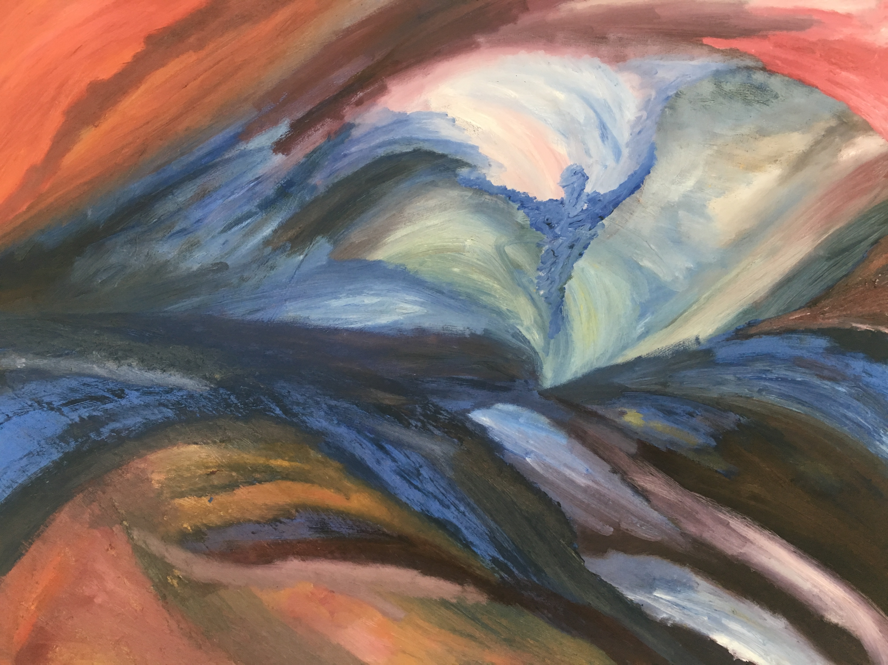
05
STEP

Slide 11
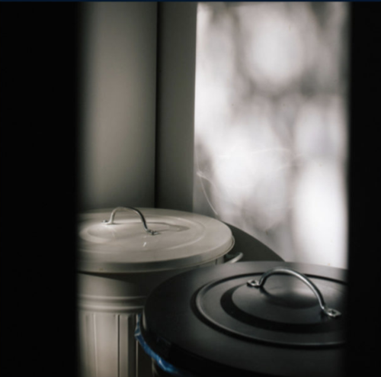
05
STEP

Slide 12
05
Reflections Video
STEP

Slide 13
Session 3: The Reality and Power
of Forgiveness
05
STEP

Slide 14
STEP FIVE
Please watch the STEPS film - Session 3
(The reality and power of forgiveness)
(link is in the chat).
We will be returning back to the main room at [insert time]

Slide 15
STEP FIVE
Thank you for joining us.
We look forward to seeing you on
[INSERT DATE] for
[STEP 6 / STEP 6/7 Workshop] (delete as appropriate)

Slide 16
WELCOME TO
STEP 6/7 Workshop
We will be starting at [insert time]

Slide 17
6&7
STEP
Prayer
God
Grant me the serenity
To accept the things I cannot change
The courage to change the things I can
And the wisdom to know the difference
Amen

Slide 18
6&7
STEP
Exercise 1: Identifying the Character defect
PRIDE | Excessive belief in one’s own abilities and achievements. In the extreme, it says “I’m better than you in all ways. I’m master.” Also regularly presenting a better version of yourself / avoiding showing real self. Being overly responsible
ENVY | jealousy, painful or resentful longing for an advantage or benefit enjoyed by another, combined with a desire to possess the same perceived benefit
GREED | selfishness, hoarding, always wanting more of everything, never being satisfied
LUST | an intense indulgence in inappropriate sexual activity
DISHONESTY | deception, justifying behaviour by explaining or representing ourselves dishonestly
LAZINESS | distinct avoidance of responsibility, not being inclined towards activity or exertion
GLUTTONY | abnormal and distorted appetites, overwhelming need for possessions, excessive drinking or eating
Other examples:
Excessive Anger - Overly-anxious - Controlling - Worry - Self-pity
Secretive - Procrastination - Negative thinking - Negative body image
Resentment - Perfectionism - Critical

Slide 19
6&7
STEP
Prayer
Dear God,
I ask for help to trust your goodness.
Give me the courage to hand over my defects to your transforming power.
Help me to stop trying to sort things out independently from you.
Thank you for not leaving me empty-handed. You don’t just take stuff away and leave me feeling exposed and vulnerable but you will help me to replace the old
destructive habits with things that bring me life, and freedom.
Things that correspond with the love and care that you have for me.
Amen

Slide 20
6&7
STEP
Exercise 2: Identifying the behaviour to change
Pick one behaviour that you will choose to focus on as you continue your journey of change
(you can refer to your notes from Step 2)
e.g.
Working Area: low self-esteem
Behaviour: refusal to accept compliments

Slide 21
6&7
6&7
STEP
Exercise 3: New desired behaviour
Today I make a decision to do what I can
to exchange ___(insert old behaviour)___behaviour with ___(insert new behaviour)___ behaviour
e.g.
Today I make a decision to do what I can to exchange my refusal to accept compliments to accepting them when they come.

Slide 22
6&7
STEP
Part 4: Plan for Change
Examples:
I got into patterns of thinking negatively and felt scared to think positively in case of disappointment. I decided to make a practice of writing down three things I am grateful for in a journal which sits next to my bed which I complete before I go to bed each night.
I struggled with low self worth and I didn't make enough time for myself. I remembered as a child I loved reading so I started a new habit of always taking a book out for myself every three weeks when I take my kids to the library.
I struggled with a lack of self care and was in a pattern of not looking after myself physically. I knew it would help with self esteem and self care, so I started small with some exercise, diarising it as a non negotiable. This meant unless I was unwell I wasn't allowed to cancel, but I had flexibility over how intensive it was. Having the non negotiable was hugely helpful as it didn't involve me having to make a decision whether to do it or not.

Slide 23
6&7
STEP
Part 4: Plan for Change
Examples:
I came to STEPS working on my need to comfort eat. I was snacking a lot between breakfast and lunch and then mid afternoon, and it was all unhealthy (chocolate, biscuits) so I made a decision that every day before I had anything for a snack I would have a piece of fruit. By the time I had finished my fruit I found I no longer wanted the unhealthy snack after (fortunately I hate fruit and chocolate together) and this has actually led to sometimes realising I don’t even need the fruit some days.
I was working on anxiety because for as long as I can remember I have been afraid of so many things. I started the simple process of writing down each day all the things I was afraid of, and then over time I began to challenge my mindset on these fears. Doing this helped me realise that some of my fears were unfounded and it took the intensity out. This has become a habit and if I start feeling fearful, I do this now as a regular practice.

Slide 24
6&7
STEP
Exercise 4: Plan for change
Be very concrete about a certain aspect of behaviour
Planning when to do something about it
Planning what to do
Asking for help
Celebrating when even small changes happen
e.g.
I am working on accepting compliments when they come
When I receive a compliment
I will smile and say thank you, without making excuses
If I get stuck I will reach out to my facilitator
I will celebrate next time I do this by writing down my achievement in my journal.

Slide 25
6&7
STEP
Part 5: Identify the support you need
Having regular conversations with someone about your journey of change (church community small group, friend, family, anyone you trust)
Making STEPS part of your annual rhythm
Using monthly insights to bring you regularly back to your process (sign up via stepscourse.org to receive these)
Using the STEPS Podcast to reflect on your process
What else?

Slide 26
6&7
STEP
Prayer
God
Grant me the serenity
To accept the things I cannot change
The courage to change the things I can
And the wisdom to know the difference
Amen

Slide 27
WELCOME TO
STEP 8 mini-workshop
We will start at [insert time]

Slide 28
08
STEP
STEP
Step 8
We made a list of all persons we had harmed and became willing to make amends to them all

Slide 29
08
STEP
STEP
The steps so far…
Step 1: our powerlessness is a strength
Step 2: the power of hope
Step 3: the joy of surrender
Step 4: be concrete and loving to ourselves
Step 5: the power of reconciliation
Steps 6 and 7: the balance of the steps process

Slide 30
08
STEP
STEP
The steps so far…
Step 1: our powerlessness is a strength
Step 2: the power of hope
Step 3: the joy of surrender
Step 4: be concrete and loving to ourselves
Step 5: the power of reconciliation
Steps 6 and 7: the balance of the steps process

Slide 31
08
STEP
STEP
The steps so far…
Step 1: our powerlessness is a strength
Step 2: the power of hope
Step 3: the joy of surrender
Step 4: be concrete and loving to ourselves
Step 5: the power of reconciliation
Steps 6 and 7: the balance of the steps process

Slide 32
08
STEP
STEP
The steps so far…
Step 1: our powerlessness is a strength
Step 2: the power of hope
Step 3: the joy of surrender
Step 4: be concrete and loving to ourselves
Step 5: the power of reconciliation
Steps 6 and 7: the balance of the steps process

Slide 33
08
STEP
STEP
The steps so far…
Step 1: our powerlessness is a strength
Step 2: the power of hope
Step 3: the joy of surrender
Step 4: be concrete and loving to ourselves
Step 5: the power of reconciliation
Steps 6 and 7: the balance of the steps process

Slide 34
08
STEP
STEP
The steps so far…
Step 1: our powerlessness is a strength
Step 2: the power of hope
Step 3: the joy of surrender
Step 4: be concrete and loving to ourselves
Step 5: the power of reconciliation
Steps 6 and 7: the balance of the steps process

Slide 35
08
STEP
STEP
Exercise 1:
Look at the list of people we have harmed (including ourselves).
We focus on things we have said or done or omitted to do. We do not focus on what we have thought or felt towards them/ourselves

Slide 36
08
STEP
STEP
Exercise 1:
Look at the list of people we have harmed (including ourselves).
We focus on things we have said or done or omitted to do. We do not focus on what we have thought or felt towards them/ourselves
Exercise 2:
Look at what we have done to harm them.
e.g If I am working on pride, I may have harmed myself because I put too much pressure on myself to perform better.
e.g. If I am working on self-esteem, I may have harmed myself by saying really bad things to ourselves about ourselves.

Slide 37
08
STEP
STEP
Exercise 3: Am I ready?
What emotions do I experience as I read through the list?

Slide 38
08
STEP
STEP
Exercise 3: Am I ready?
What emotions do I experience as I read through the list?
To each person on the list, ask yourself the following:
To whom of these people am I ready to make amends?
To whom am I almost ready to make amends?
To whom will I probably never make amends?
(Because it may harm myself, them or others, or they may have died)

Slide 39
08
STEP
STEP
Exercise 3: Am I ready?
What emotions do I experience as I read through the list?
To each person on the list, ask yourself the following:
To whom of these people am I ready to make amends?
To whom am I almost ready to make amends?
To whom will I probably never make amends?
(Because it may harm myself, them or others, or they may have died)

Slide 40
08
STEP
STEP
Exercise 3: Am I ready?
What emotions do I experience as I read through the list?
To each person on the list, ask yourself the following:
To whom of these people am I ready to make amends?
To whom am I almost ready to make amends?
To whom will I probably never make amends?
(Because it may harm myself, them or others, or they may have died)

Slide 41
WELCOME TO
STEP 11 - Connection Session
We will start at [insert time]

Slide 42
11
STEP
STEP
Prayer
God
Grant me the serenity
To accept the things I cannot change
The courage to change the things I can
And the wisdom to know the difference
Amen

Slide 43
11
STEP
STEP
Step 11
We sought through prayer and meditation to improve our conscious contact with God, praying only for the knowledge of His will for us and power to carry that out.

Slide 44
11
STEP
STEP
Time of Reflection

Slide 45
11
STEP
STEP
St. Patricks Shield
Jesus, you stand before me…
You stand behind me
You are on my right side
You are on my left side
You are beneath me..
And you are above me…
Jesus you surround me on all sides…
You live in my heart
And you penetrate my soul
And you love me
Jesus my Lord…

Slide 46
11
STEP
STEP
Mark 2: 1-12
A few days later, when Jesus again entered Capernaum, the people heard that he had come home. ² They gathered in such large numbers that there was no room left, not even outside the door, and he preached the word to them.
³ Some men came, bringing to him a paralysed man, carried by four of them. ⁴ Since they could not get him to Jesus because of the crowd, they made an opening in the roof above Jesus by digging through it and then lowered the mat the man was lying on. ⁵ When Jesus saw their faith, he said to the paralysed man, “Son, your sins are forgiven.”
⁶ Now some teachers of the law were sitting there, thinking to themselves, ⁷ “Why does this fellow talk like that? He’s blaspheming! Who can forgive sins but God alone?”
⁸ Immediately Jesus knew in his spirit that this was what they were thinking in their hearts, and he said to them, “Why are you thinking these things? ⁹ Which is easier: to say to this paralysed man, ‘Your sins are forgiven,’ or to say, ‘Get up, take your mat and walk’?
¹⁰ But I want you to know that the Son of Man has authority on earth to forgive sins.” So he said to the man, ¹¹ “I tell you, get up, take your mat and go home.” ¹² He got up, took his mat and walked out in full view of them all.

Slide 47
11
STEP
STEP
Thank you for joining us.

Slide 48
12
STEP
How to stay in the process:
Do STEPS again
Sharing your story with those in your community
Facilitating a space for others to go on this journey with you
Finding someone to regularly check in on your process with (fellow participant, friend, etc)
Use the The STEPS Podcast as a way to connect with the steps regularly
Use the STEPS monthly insight email to refresh yourself in the tools of STEPS (sign up via stepscourse.org)

